Slide 1
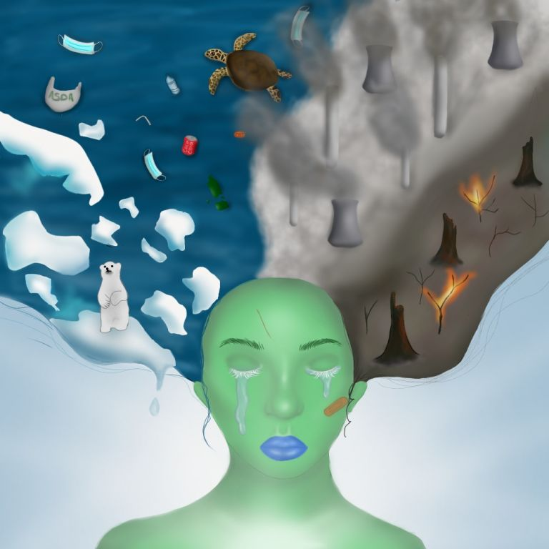
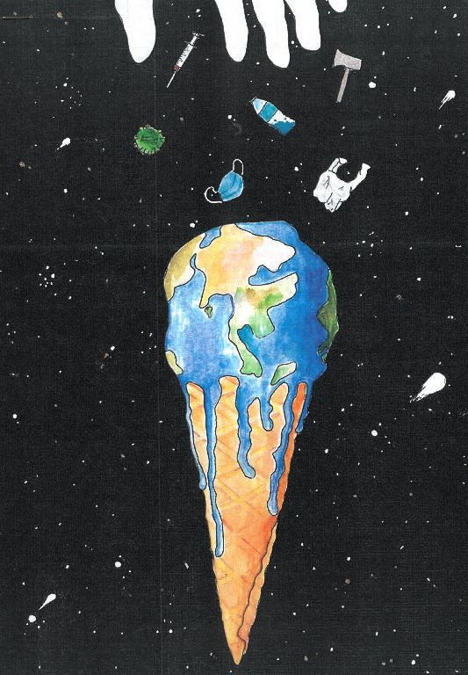
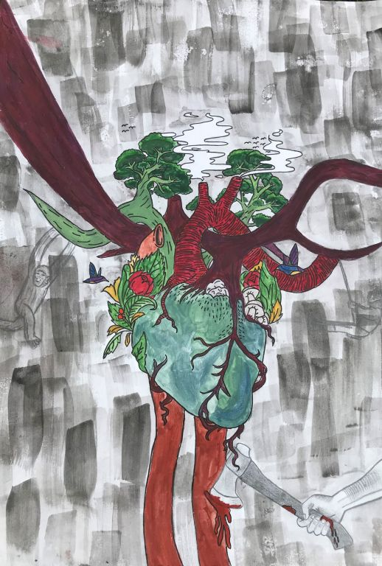
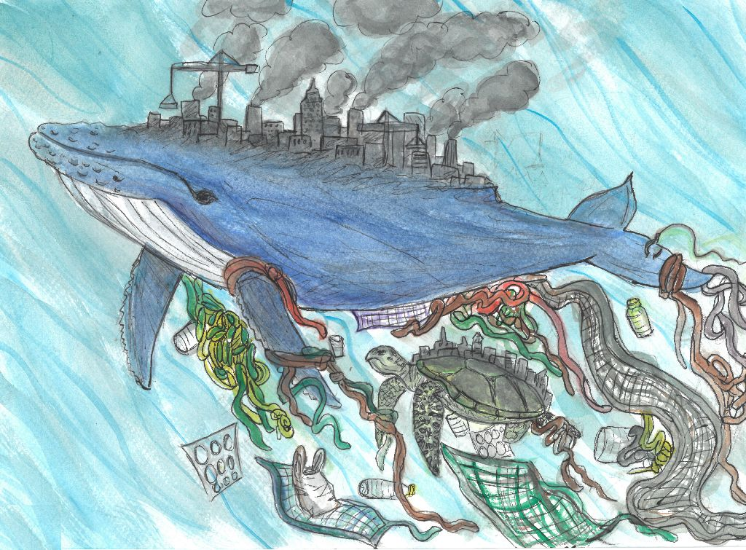
What do you think this art is showing?
“Blossoming and Breathing”
in my artwork there is a human heart and instead of lungs there are trees, flowers and other aspects of nature. What I like best about my work is the symbolism of the lungs as plants, which is a necessity to all humans.
Iman, 13
“Humankind”
Both animals have a dark grey city skyline on their backs with thick grey smoke coming from the buildings. I did this to symbolise air pollution I put it on their backs to show that innocent creatures like these are hard to carry the weight of humankind's mistakes and are suffering because of us.
Bella, 13
“The Earth’s Sorrow”
In my artwork I decided to represent the earth as a human, showing the consequences of climate change in her hair and through physical wounds.
Eva, 13
“A Ruined Gift”
My artwork is all about what is happening to earth and all of the damaging things that we are doing to it. This good earth has been turned bad. God creates everything and gives us our job: to look after it.
Taia, 12
Notes:
https://www.natre.org.uk/about-natre/projects/spirited-arts/spirited-arts-gallery/2021/?page=1&ThemeID=95

Slide 2
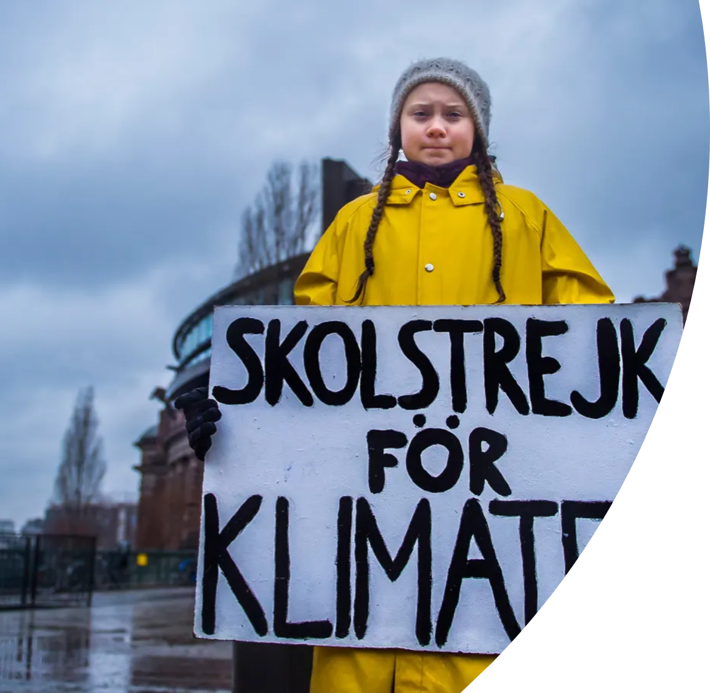
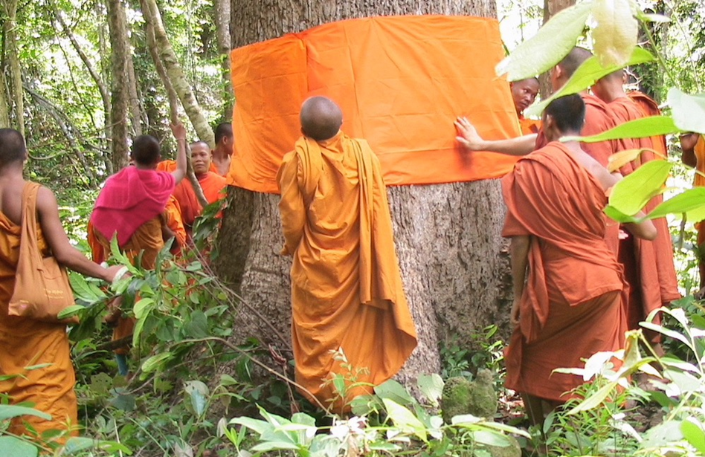
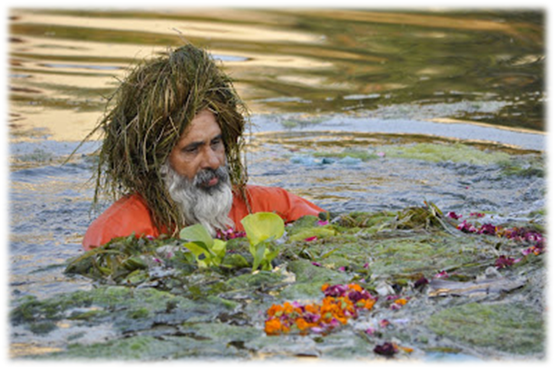
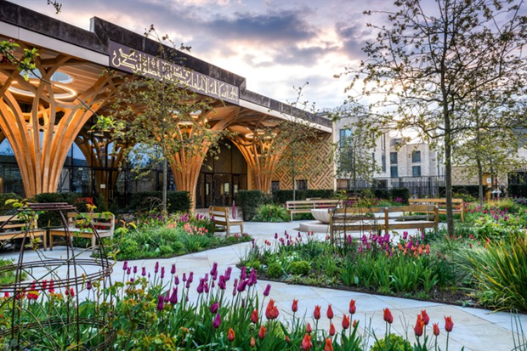
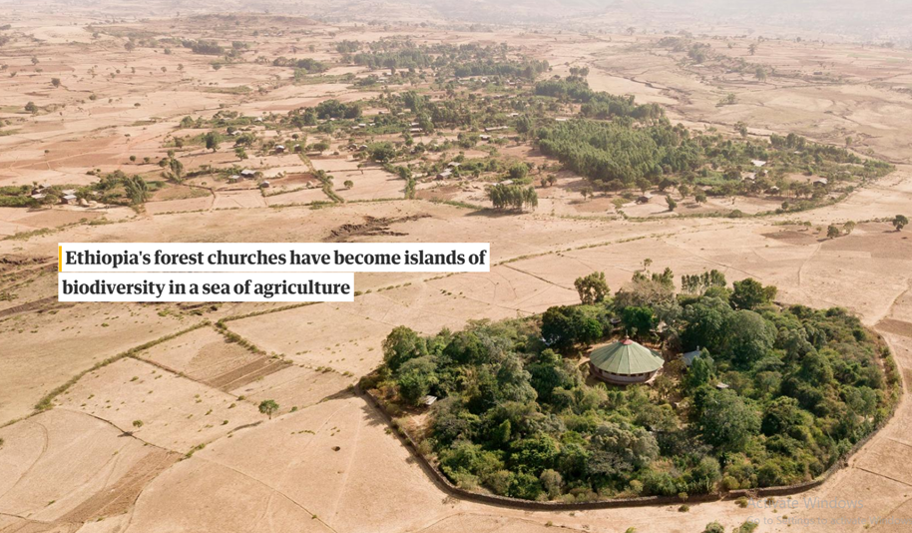
Do now activity…
In two sentences or less, who is Greta Thunberg and why is she famous?
Give two religious projects where people have fought climate change.
Greta Thunberg brought attention to politicians not doing enough to combat climate change by striking from school.
“Eco Baba”, Buddhist monks ordaining trees, Cambridge eco mosque, Ethiopian church forests.

Slide 3
Climate Change Lesson 6: Individual responses.
Learning Intention: To reflect on what we’ve learnt about climate change and religion.
Success criteria 1: To reflect on what we’ve learnt over the last 6 weeks.
Success criteria 2: To play a game – blockbusters.
Success criteria 3: To create something that reflects what we’ve learnt over the last 6 weeks.

Slide 4
Success criteria 1: To reflect on what we’ve learnt over the last 6 weeks.
Think about everything we’ve learnt about climate change and religious responses.
Complete the pyramid below while discussing the topic with your partner.
One thing you will take away with you and possibly think about for the future.
Two things you have found interesting.
Three key words or terms you’ve learnt.
Notes:
Have a discussion with the class about what they have put down.

Slide 5
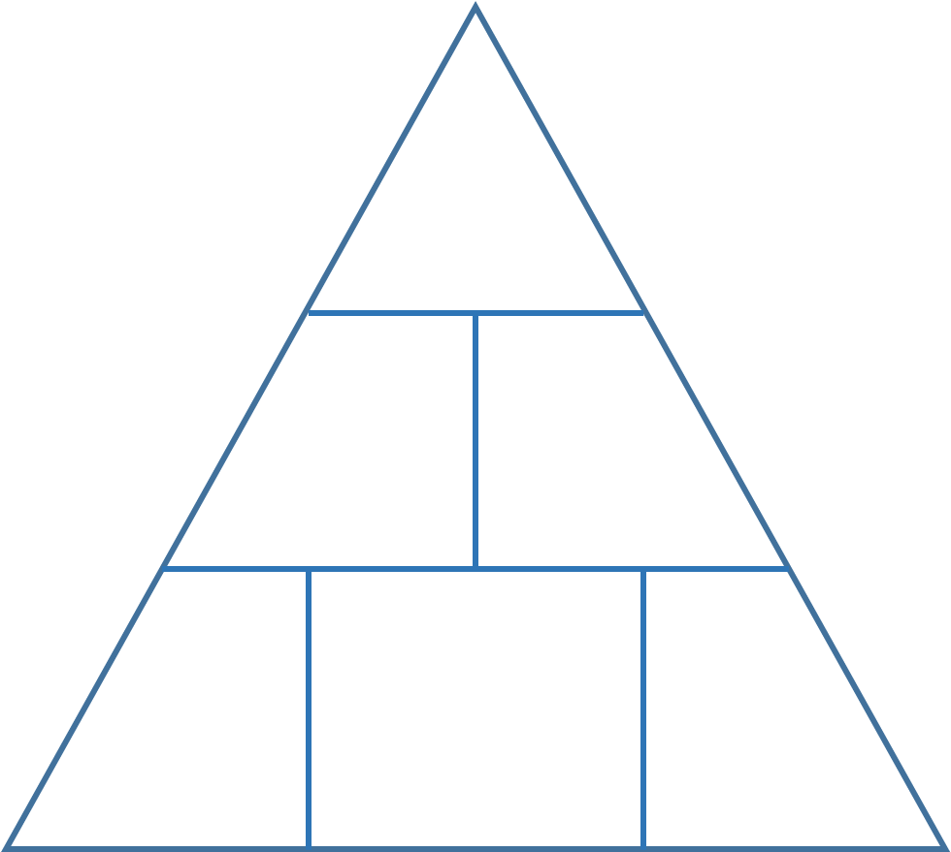
Notes:
Could be printed for classes to save time.

Slide 6
Success criteria 2: To play a game - blockbusters.
We’re going to play a game now.
We will be in two teams – blue and white.
The rules are fairly simple:
-the first team to get across the board (linking their colour) wins.
-each team takes it in turn to answer a question.
-the letter on the board is the first letter of the answer.
-you are limited to 3 guesses as a team and no longer than 30 seconds.
-don’t shout out answers for the others team!
Notes:
Teacher: you’ll need to either print out the answers to read whilst the board is on screen or take a picture with your phone.

Slide 7


The Rules
2 teams.
One go at a time.
The letter on the
board is the first
letter of the
Answer.
The Rules
First team to
get across
the board
Wins.
If no team gets
across the
board, the
team with
the most
hexagons
Wins.

Slide 8
8. EB
16. GT
1. D
9. A
7. G
15. C
2. FF
10. GIA
H
6. D
14. E
3. x3
11. S
5. M
13. DL
4. NEP
12. CF

Slide 9
D. The Christian idea that humans are in charge of the planet/have power over it. –Dominion.
FF. Burning these causes climate change. –Fossil fuels.
x3. Give three things we can do to combat climate change. –
NEP. This guides Buddhists on how to live their lives. (clue-it is the Buddhist symbol). –Noble Eightfold Path.
M. Muslims might argue we should care for the environment for public interest/wellbeing. What’s the key term for this? –Maslahah.
D. One cause of climate change. Cutting down trees. –Deforestation.
G. Christians explain that humans have a inbuilt disobedience, that started with Adam and Eve. Where are they in the Bible? –Genesis.
EB. Nickname of the Sikh who cleaned up 160km of river in the Punjab. – Eco Baba.
A. The Buddhist idea of not harming other living things. –Ahimsa.
GIA. Buddhists believe that Three Poisons drive suffering. Name two of them. – Greed, Ignorance, Anger.
S. The Christian idea that we should care for the planet. –Stewardship.
CF. The total amount of greenhouse gases (including carbon dioxide and methane) that are generated by our actions–Carbon footprint.
DL. The name of the Buddhist leader who argues we should care for the environment. –Dalai Lama.
E. In which country would you find church forests? –Ethiopia.
C. Where is Europe’s first eco-friendly mosque located? – Cambridge.
GT. The name of the girl who went on school strike to raise awareness of politicians lack of action on climate change. –Greta Thunberg.

Slide 10

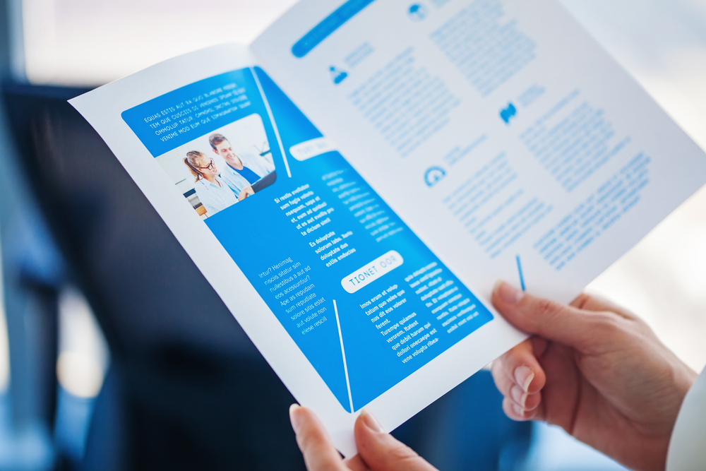
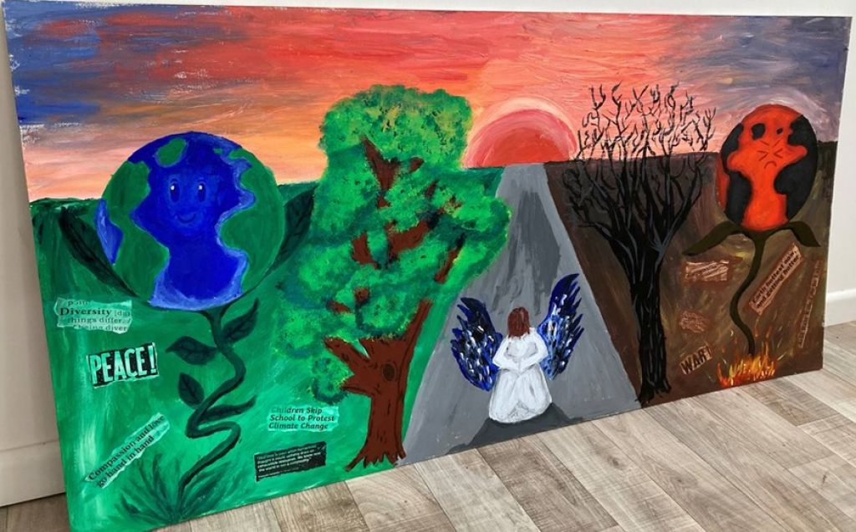

Success criteria 3: To create something that reflects what we’ve learnt over the last 6 weeks.
The last part of this topic is something creative and up to you individually.
You are going to create something to show what you’ve learnt over the last 6 weeks. It could be on the whole topic, or just one specific area.
Your homework will be to finish what you start – so you can think big!
There are ideas below to give you inspiration…
Or anything else you want to try.
Ask me before starting.
A speech.
A leaflet.
Art – this is called “Impact Two Worlds”. Source: NATRE.
Notes:
Please see word document for word version of Genesis 3.

